Slide 1
NO VISITORS TO MY HOME

Slide 2
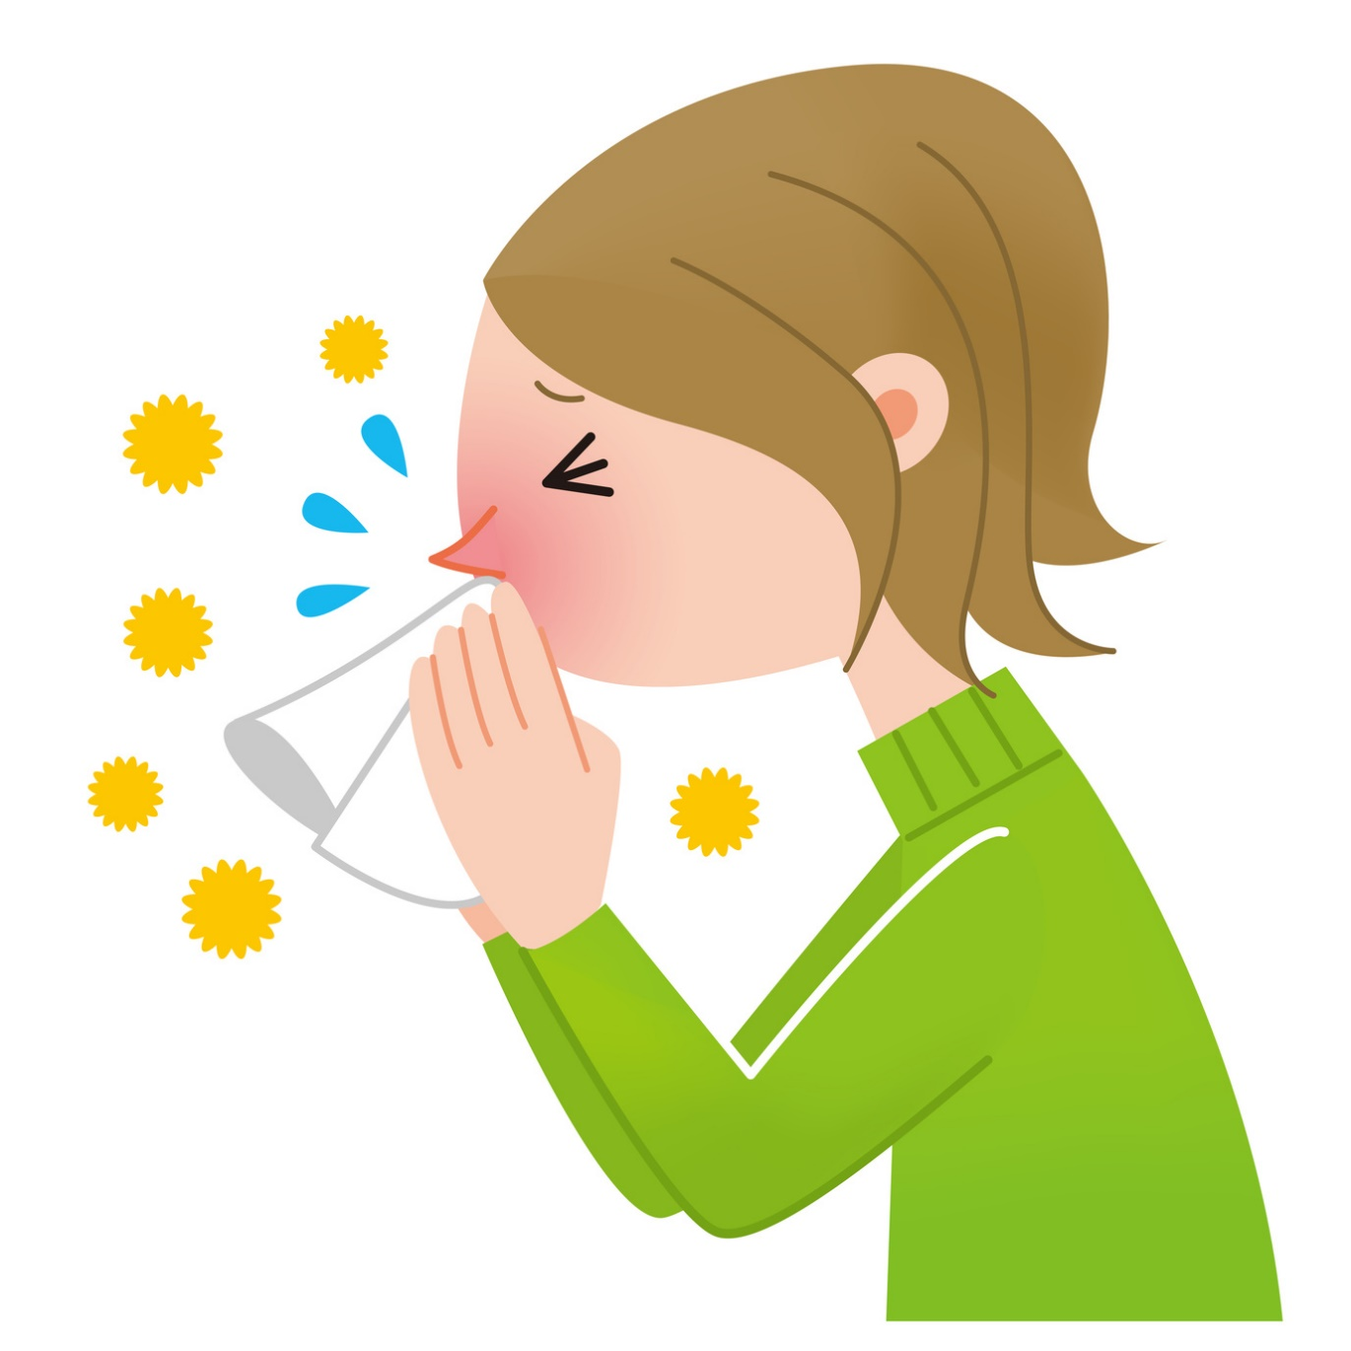
Sometimes people get sick from a cold or flu virus.
The coronavirus is similar to a cold or flu virus and it spreads very easily.

Slide 3
It is important to prevent coronavirus germs from entering into my home.
Coronavirus Germs
My Home

Slide 4
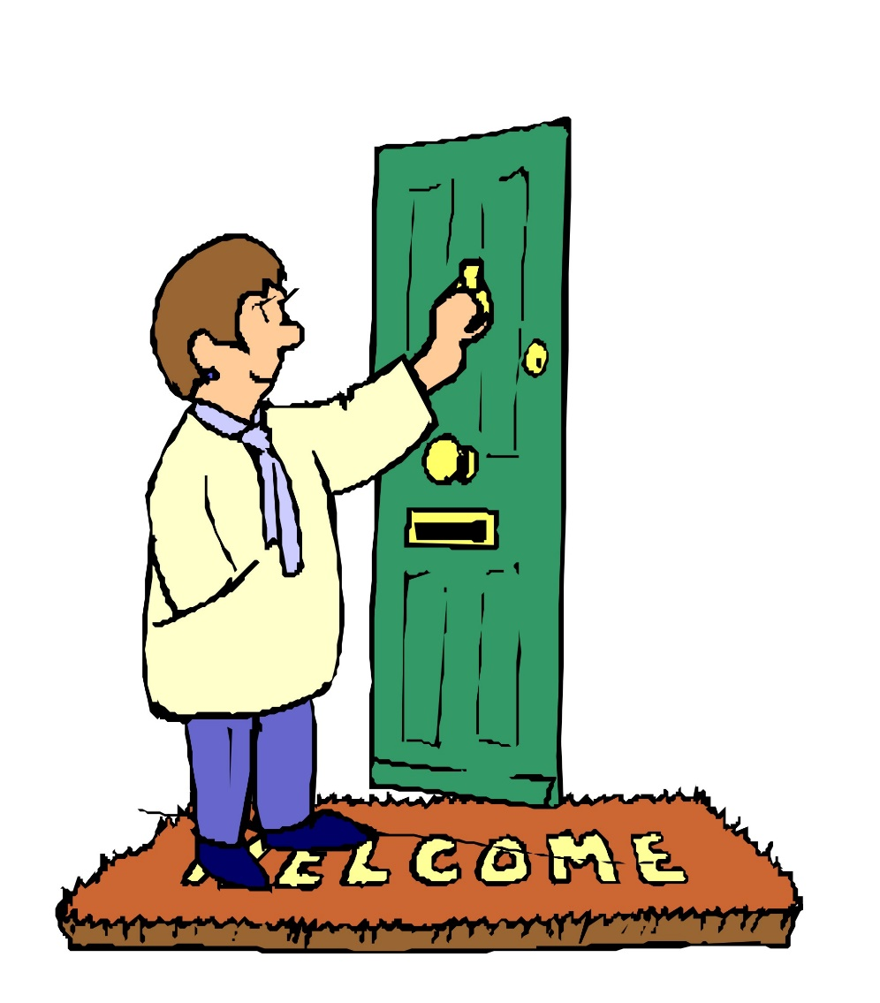
To do this, no visitors will be allowed in my home right now.
Visitors
My Home

Slide 5
This means, my family and friends will not
be coming to visit me at home right now.

Slide 6
This will help prevent the spread of coronavirus germs.
This will help to keep me, my housemates and staff safe and healthy.

Slide 7
Not having visitors to my home is temporary.
Life will go back to normal soon. Family and friends will come visit me at my home then.

Slide 8
Knowing that I will not have any visitors to my home right now,
might make me feel different emotions.
It is okay to feel this way.

Slide 9
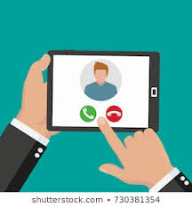
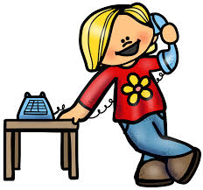
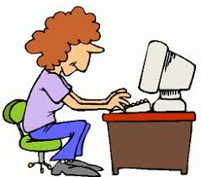
These are some other ways I can see or talk to my family and friends.
Facetime
Phone Call
Email
Text/Whatsapp

Slide 10
My staff and family are here to support me.
If I have questions or need support I can talk to them.

